Slide 1
How to Create a Workshop.. Teach, Resource & Deliver the Units
2020-1-UK01-KA205-078066

Slide 2
Planning the Workshop
Course Materials
Understand how to close the workshop
Planning the Workshop

Slide 3
Create an introduction to include ground rules and an ice-breaker.
Decide how you will introduce yourself and the topic to the participant members to include learning objectives.
Look at the order of delivery of each topic in the workshop.
What are the learning objectives?
How much time do you have for the workshop? Factor in any breaks.
At the planning stage make sure you set time aside for practising the delivery of the workshop.
Read through all the materials before you start – the PowerPoint slides provided and the workbook.
Planning the Workshop

Slide 4
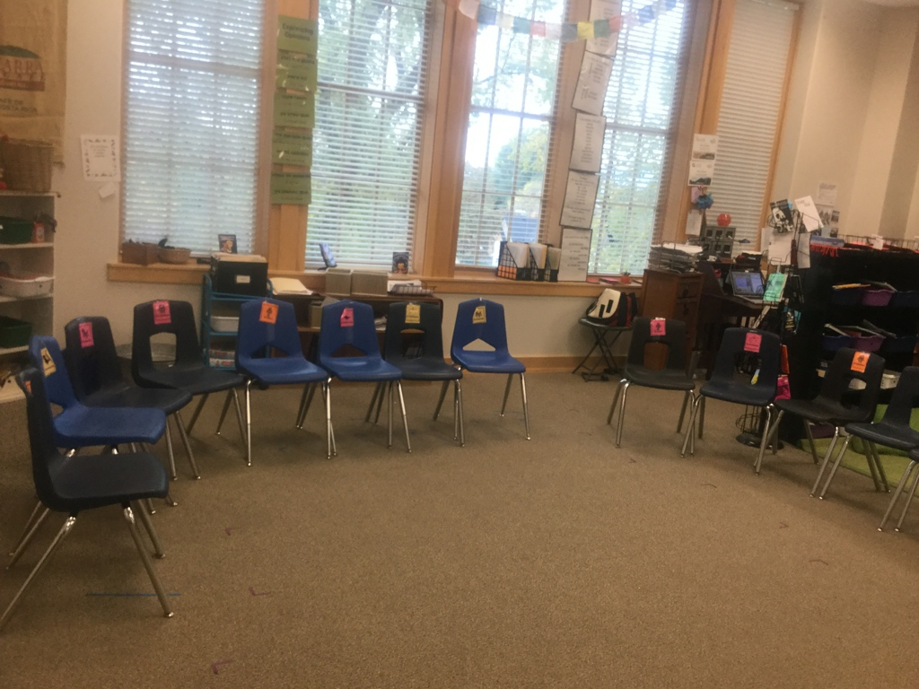
Setting up the room
To encourage everyone to get involved, set the room in a horse-shoe shape or a semi-circle so that everyone can see each other.
Planning the Workshop
Notes:
Facilitators:
♦ Set a positive tone for discussion ♦ Remain neutral to the issues ♦ Keep the group focused ♦ Keep track of time ♦ Suggest methods and procedures that can help the group work better ♦ Encourage participation by everyone ♦ Educate/Inform participants about activities and steps ♦ Protect ideas from challenge ♦ Coordinate administrative details ♦ Record information or supervise its recording SET THE CLIMATE FOR THE SESSION: Clarify the purpose and what the expected outcomes of the meeting ♦ Introduce yourself and the role you will play ♦ Explain the agenda, ground rules and any handouts ♦ If comfortable, use an icebreaker or introduction type of activity

Slide 5
Suitable room with enough chairs for everyone, preferably, with some space to do role plays
Flip chart, paper and marker pens
Projector to run PowerPoint
Stationary
Resources
Notes:
Facilitators:
♦ Set a positive tone for discussion ♦ Remain neutral to the issues ♦ Keep the group focused ♦ Keep track of time ♦ Suggest methods and procedures that can help the group work better ♦ Encourage participation by everyone ♦ Educate/Inform participants about activities and steps ♦ Protect ideas from challenge ♦ Coordinate administrative details ♦ Record information or supervise its recording SET THE CLIMATE FOR THE SESSION: Clarify the purpose and what the expected outcomes of the meeting ♦ Introduce yourself and the role you will play ♦ Explain the agenda, ground rules and any handouts ♦ If comfortable, use an icebreaker or introduction type of activity

Slide 6
DECIDE WHO WILL ATTEND
Think about candidate numbers
Do they have any special needs, if yes what are they?
This workshop would work well for up to a maximum of 20 people
Planning the Workshop
Notes:
Facilitators:
♦ Set a positive tone for discussion ♦ Remain neutral to the issues ♦ Keep the group focused ♦ Keep track of time ♦ Suggest methods and procedures that can help the group work better ♦ Encourage participation by everyone ♦ Educate/Inform participants about activities and steps ♦ Protect ideas from challenge ♦ Coordinate administrative details ♦ Record information or supervise its recording SET THE CLIMATE FOR THE SESSION: Clarify the purpose and what the expected outcomes of the meeting ♦ Introduce yourself and the role you will play ♦ Explain the agenda, ground rules and any handouts ♦ If comfortable, use an icebreaker or introduction type of activity

Slide 7
These are set at the start of your workshop within your introduction and can be agreed with your group.
What sort of things should be included within your ground rules?
How to set the ground rules?

Slide 8
Respect each speaker.
Be back on time after any breaks
Not to use mobile phones within the workshop
Take turns speaking
Don’t talk about sensitive subjects
Active listening
Ground Rules

Slide 9
An opening exercise such as an icebreaker is useful to start up a
training session. As the name suggests, icebreakers are designed to
“warm up” the session. • Icebreakers are commonly presented as a game to "warm up" the group by helping the members to get to know each other.
Ice breakers can be used at the start or at any time of the training program.
Ice-breakers

Slide 10
This is most important and crucial step for rapport building. As the facilitator make sure everyone is welcome. Communicate clearly. Tell everyone what the objectives of the training are. Why this program is being conducted. How this program will benefit the participants and their roles as Youth Workers. Set the ground rules. Do an ice-breaker In this way, participants will be more receptive to learning before they can actually start to learn. Create a warm, friendly environment
Opening the training..
A friendly welcome.

Slide 11
LEARNING OBJECTIVES
Objectives – share these with your participants and go back to these at the end of the training to make sure everything has been covered and understood.
Learning Objectives
Notes:
Facilitators:
♦ Set a positive tone for discussion ♦ Remain neutral to the issues ♦ Keep the group focused ♦ Keep track of time ♦ Suggest methods and procedures that can help the group work better ♦ Encourage participation by everyone ♦ Educate/Inform participants about activities and steps ♦ Protect ideas from challenge ♦ Coordinate administrative details ♦ Record information or supervise its recording SET THE CLIMATE FOR THE SESSION: Clarify the purpose and what the expected outcomes of the meeting ♦ Introduce yourself and the role you will play ♦ Explain the agenda, ground rules and any handouts ♦ If comfortable, use an icebreaker or introduction type of activity

Slide 12
USING THE POWERPOINT
You can use the powerpoint slides in the order that they are in.
Some of the slides can be missed out if you think that they are not relevant to your group.
Use the slides as a guide and try not to read off them.
Stop and start the slides as you want to.
If you only have time for a shorter workshop you may not need to use all the slides.
Using the PowerPoint
Notes:
Facilitators:
♦ Set a positive tone for discussion ♦ Remain neutral to the issues ♦ Keep the group focused ♦ Keep track of time ♦ Suggest methods and procedures that can help the group work better ♦ Encourage participation by everyone ♦ Educate/Inform participants about activities and steps ♦ Protect ideas from challenge ♦ Coordinate administrative details ♦ Record information or supervise its recording SET THE CLIMATE FOR THE SESSION: Clarify the purpose and what the expected outcomes of the meeting ♦ Introduce yourself and the role you will play ♦ Explain the agenda, ground rules and any handouts ♦ If comfortable, use an icebreaker or introduction type of activity

Slide 13
Make sure the participants know what they are going to role play.
Make sure that each person knows their role.
Set the role plays in small groups, spread around the room so that each group can hear themselves.
Do a practice role play to show the group before asking them to do one.
Give the participants a time for doing the role plays, this will very much depend on how many people there are.
Reflection, after the role plays ask the students how they feel that they got on? Ask them to complete the reflection sheet in the workbook.
How to facilitate the Role Plays?

Slide 14
Think about ways that you can do this?
Make it interactive
Use the suggested activities
Use an icebreaker to maybe two
Vary the activities
Ask people questions
Encourage discussion
During the Workshop get people involved

Slide 15
Why are these ways so important?
To keep everyone involved.
So that people learn new ideas and ways of doing things.
So nobody gets bored.
So people go away and tell their friends how much they enjoyed the training
Do this by including games, one to one working, peer working, group exercises and ensuring that breaks are incorporated into the day
During the Workshop get people involved

Slide 16
Brainstorming or mind-mapping is used to:
To generate ideas.
To get everyone involved.
Good for problem solving.
It gives everyone a visual focus too, so put participants answers on the flip chart for everyone to see.
There are plenty of opportunities to use this within the slides.
How to use Brainstorming in the workshop?

Slide 17
This is a really important aspect of delivering a workshop.
If you as the facilitator are motivated and dynamic your group members will be too.
Your behaviour will influence their behaviour.
Why is this?
Attitide a way of thinking or behaving and your participants will follow you.
Motivation

Slide 18
Where you encourage other youth workers to draw from each others experiences to support each other, working in pairs.
An effective way of knowledge sharing – those with more experience help those with less experience.
You can put individuals in pairs for some of the activities, maybe someone who is more capable with someone who is less capable.
Helps others to develop friendships.
Peer Support

Slide 19
Choose who will pair up with who
Demonstrate how they can give feedback to each other.
Demonstrate how they can ask each other questions.
Explain how to give each other positive feedback using kind words.
Explain the advantages of peer support in helping each other by sharing knowledge.
How to use Peer Working in the workshop?

Slide 20
Ask questions to check for understanding at any point in the workshop.
Don’t forget to check if anyone has any questions at the end of the workshop.
The main types of questioning styles that you can use as a facilitator are in the facilitation and coaching powerpoint and workbook.
The importance of Questioning

Slide 21
Giving feedback is an important aspect of facilitation and coaching.
Giving feedback should be positive and encouraging.
You can praise participants on their effort in your workshop, for example this might be for providing some good answers or simply participating and helping others.
Feedback should never be negative and aggressive.
Feedback can be constructive too, as long as this is done in a friendly and encouraging way.
Examples of words and phrases that can be used are on the next 2 slides.
Giving Feedback to your participants in the Workshop

Slide 22
Giving Feedback to your participants in the Workshop

Slide 23
Giving Feedback to your participants in the Workshop

Slide 24
Build a safe environment. As the facilitator make sure that you make participants feel safe enough to share their thoughts, experiences, and questions. They need to be open and ready to accept constructive input, and also have the courage to ask questions.
To build a safe environment, set ground rules.
Some suggestions: confidentiality must be honoured; feedback should be perceived as a generous gesture that should always be met with gratitude; participants should practice empathy, putting themselves in others’ shoes; and participants should never be mocked or embarrassed for expressing themselves in front of their peers.
Create a safe workshop

Slide 25
IMPACT OF LEARNING
Think about what you want the trainees going away with.
Save some time at the end of the workshop to discuss with the participants what went well, what they enjoyed and what they’d like to learn more about.
An idea for doing this is: Give each person 2 post-it notes which are different colours. One one the person must say what they enjoyed and on the other what they didn’t enjoy so much or what they’d like to learn more about.
Reflection

Slide 26
ASSESSMENT
There are 2 main types of assessment incorporated into this training.
FORMATIVE – (ASSESSMENT FOR LEARNING) will be continuous throughout the training. By completing the questions within the power point slides with your learners and those in the workbook this will allow for learners to work at and contribute at their own pace.
Ongoing feedback from the facilitator will be used to check and moitor progress of the learners, mainly by group discussion and direct questioning.
SUMMATIVE – this is how student learning will be evaluated at the end of the training and this can be done with this training in two ways. By way of the practical, role play assessments and by way of the successful completion of each of the workbooks with this course. One on coaching and the other on facilitation and communication.
Assessment

Slide 27
5 Tips to Make Your Remote Workshop a More Interactive Experience
Make the most out of your chosen hosting tool, for example Teams or Zoom.
Use shared documents instead of flip charts or a whiteboard.
Enable all participants to use videos and chat.
Engage volunteers to take part.
Use the break out rooms for pair work and role plays.
Remote Workshops using software such as Teams or Zoom

